Slide 1


STaP
Sedimentation Tank pH
Optimizing sedimentation by investigating sedimentation tank performance at varying pH and coagulant dosage.
More at: https://github.com/AguaClara/SedTank-pH
Isabel Corvella | isc25@cornell.edu Dennis Wu | djw323@cornell.edu
Elizabeth Bunker | elb248@cornell.edu
Sedimentation Tank pH | Research | Symposium Presentation Spring 2022
Notes:
Abstract:
The sedimentation tank pH subteam aims to analyze how changing pH in sedimentation affects the overall performance of the process. More specifically, the team seeks to optimize the pH alongside a constant coagulant dosage for the sedimentation of clay contaminants. This will be done by measuring the turbidity of effluent water after sedimentation. This team currently has no laboratory data.
Full Report:
https://colab.research.google.com/drive/1UgTxD01CTpg5lhKjWtBPL31Z09Tti5LU

Slide 2
Table of Contents
Background
Schematic Drawing
Experimental Setup
First Steps
Future Tasks
Questions and Recommendations
Sedimentation Tank pH | Research | Symposium Presentation Spring 2022

Slide 3
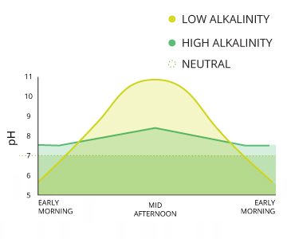
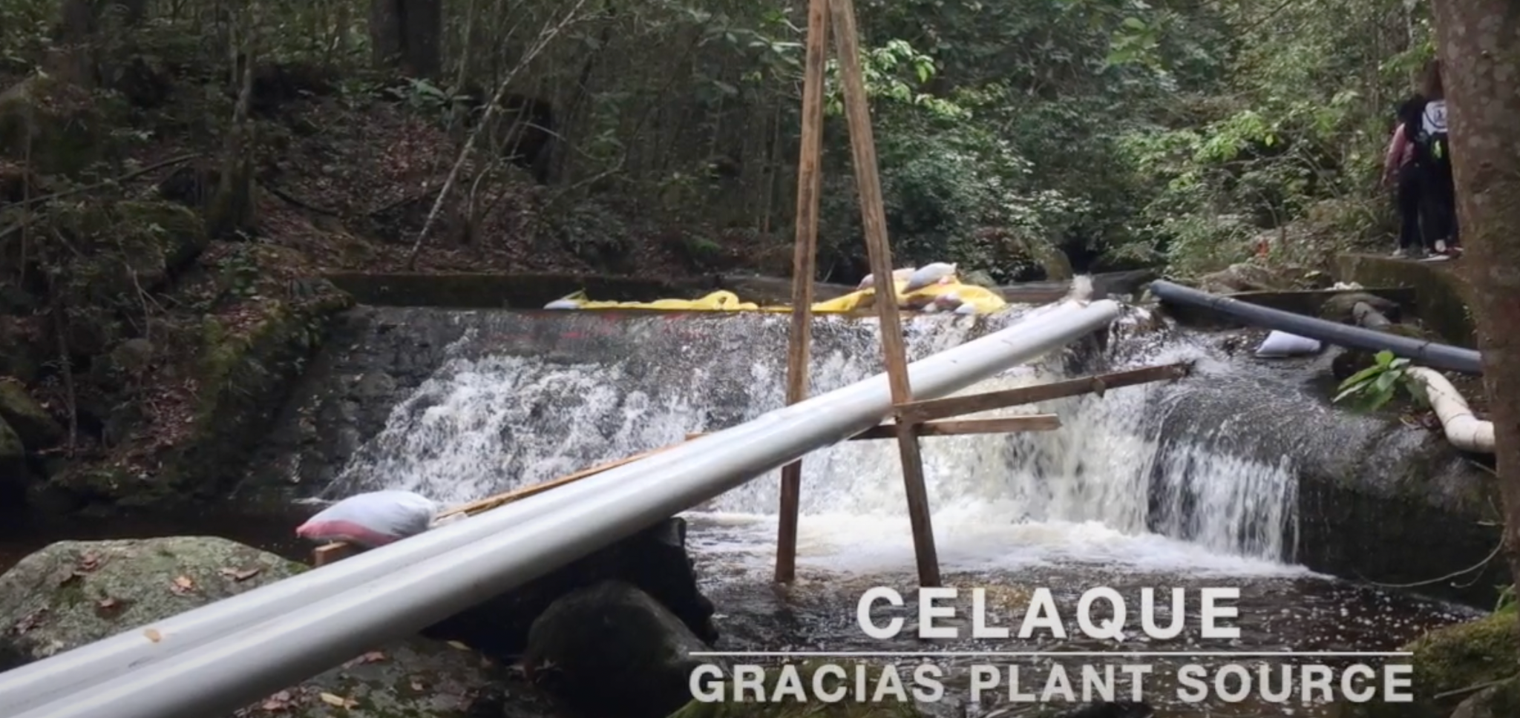
Background
AguaClara plants use streams and rivers to supply the water, can vary greatly in pH (6.5-8.5)
algal photosynthesis and respiration
acidic rain and other weather events
mineral presence and concentration (alkalinity)
Figure 1: pH Variation Over Time
Figure 2: AguaClara Influent Water Supply
Sedimentation Tank pH | Research | Symposium Presentation Spring 2022
Notes:
Citations:
Fondriest Environmental, Inc. (2019, January 23). Ph of Water. Environmental Measurement Systems. Retrieved March 20, 2022, from https://www.fondriest.com/environmental-measurements/parameters/water-quality/ph/#p7
NASA. (n.d.). Water quality. Crooked River Project. Retrieved March 20, 2022, from https://www.grc.nasa.gov/www/k-12/fenlewis/Waterquality.html#:~:text=The%20pH%20of%20river%20water,river%20water%20is%20around%207.4.
Figures:
Figure 1 shows the variation of pH over a day at different alkalinities (Fondriest Environmental, Inc). Figure 2 shows an example of the water sources to be purified in the AguaClara plants.
Description:
Since AguaClara plants use streams and rivers as their water supply, this water is subject to a lot of pH variation due to weather, algal photosynthesis and respiration, and general geography.

Slide 4
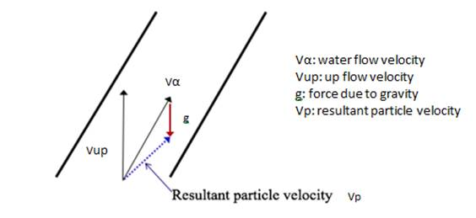
Background Continued
Based off previous research and observation, a change in pH could change how flocs interact with each other in tank
Clay particles are mostly negatively charged while coagulant is positively charged
Changing pH can also change the viscosity of water
Flocs might fall faster or slower when forming floc blanket
Figure 3: Resultant Particle Velocity Diagram
We want to determine the optimal pH for sedimentation to help understand and minimize this variation
Sedimentation Tank pH | Research | Symposium Presentation Spring 2022
Notes:
Citations:
Vesga-Rodríguez, C. P., Donado-Garzón, L. D., & Weber-Shirk, M. (2018, November 19). Evaluation of high rate sedimentation lab-scale tank performance in drinking water treatment. Revista Facultad de Ingeniería Universidad de Antioquia. Retrieved March 20, 2022, from https://www.redalyc.org/journal/430/43065097002/html/
Different factors will change how efficient sedimentation is: temperature and pH can both change viscosity which changes the velocity of settling flocs, which is change the extent of sedimentation.
Figures:
Figure 3: Shows the calculation of particle settling velocity, indicates importance of water flow velocity, which is thought to be varied based on pH (Vesga-Rodriguez)
Description:
Based off previous research and observation, a change in pH could change how flocs interact with each other in tank. Since the flocs are partially charged, this effect is compounded. Clay particles are mostly negatively charged, while coagulant is positively charged. Although these components are stuck together during flocculation, acid and base may change these interactions and any residuals if it’s introduced before sedimentation. Acids and bases are made up of positive and negative components, which could possibly stabilize the charges of coagulant and clay in solution.
Additionally, changing pH can also change the viscosity of water, and therefore flocs might fall faster or slower when forming floc blanket at certain pHs.
Finding out the ideal pH can help us work on steps to stabilize the pH at the optimal level and inform plant operators on sedimentation rates based on water pH, which is testable.

Slide 5
Schematic Drawing
clay
coag.
turbidimeter
clay pump
coag. pump
turbidimeter
flocculator
sedimentation tank
water pump
acid pump
Waste
water
acid
Figure 4: Schematic Drawing of the experimental setup for testing varying pH
Sedimentation Tank pH | Research | Symposium Presentation Spring 2022
Notes:
Figures:
Figure 4 is described below
Description:
Our experimental setup includes 4 pumps: one for water, clay, acid, and coagulant (PACl), two turbidimeters, a flocculator, and a sedimentation tank. In order to measure what pH optimizes sedimentation, we will first measure the turbidity of influent water mixed with clay,a and then remeasure turbidity after the water has gone through flocculation and sedimentation. Acid is pumped into the main tubing pathway after flocculation, and right before sedimentation occurs. Settled flocs will be pumped out, and the remaining water will be pumped into the second turbidimeter to measure how the turbidity has changed from before and after the water treatment process. The outflow will then be connect to the effluent flocs from the tank, and be disposed of as waste.

Slide 6
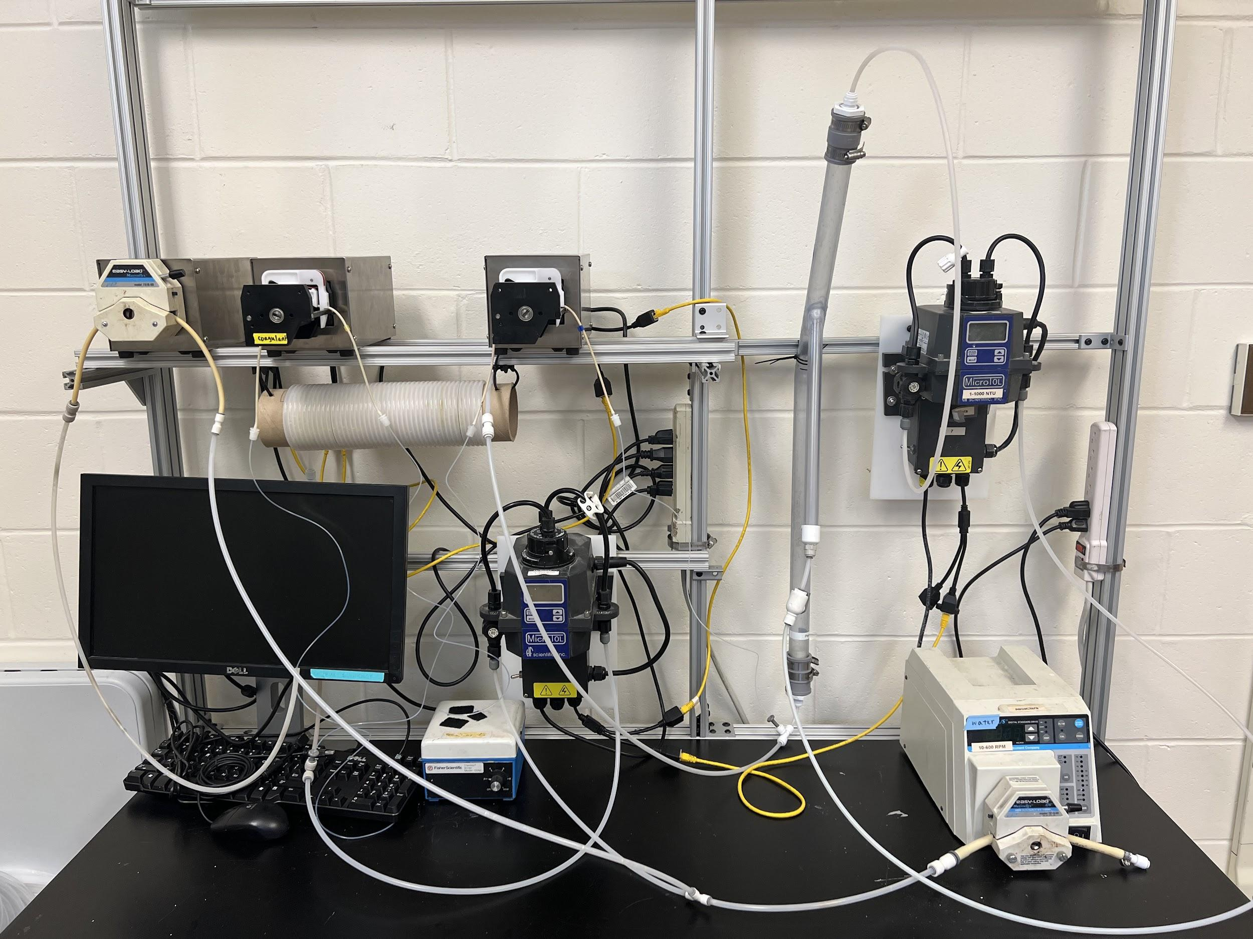
Experimental Setup
Sedimentation Tank
Pumps: clay, coagulant, acid
Effluent Turbidimeter
Flocculator
Influent Turbidimeter
Water pump
Figure 5: Image of experimental lab setup in Hollister
Sedimentation Tank pH | Research | Symposium Presentation Spring 2022
Notes:
Description:
This setup is the same as the schematic drawing.

Slide 7
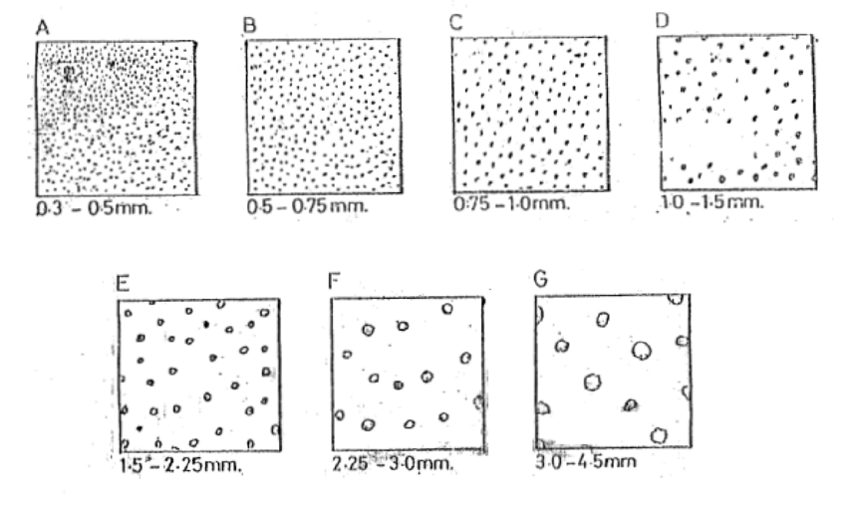
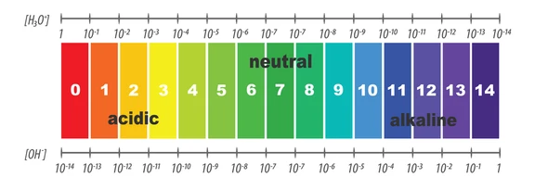
First Steps
Literature review: understanding the set-up of our sedimentation tank system
Knowing which variables might affect sedimentation, including viscosity, floc size and type, as well as salt content
Understanding how pH either affects or is affected by these variables
Building our lab set-up based on past teams, altering for our specific needs
Challenges: getting set up and acquiring necessary materials
Figure 6: Diagram of varying floc sizes based on diameter
Figure 7: pH scale based on [H₃O⁺] and [OH⁻]
Sedimentation Tank pH | Research | Symposium Presentation Spring 2022
Notes:
Citations:
Swift, T., Swanson, L., Bretherick, A., & Rimmer, S. (2015). Measuring poly(acrylamide) flocculants in fresh water using inter-polymer complex formation. Environmental Science: Water Research & Technology, 1(3), 332–340. https://doi.org/10.1039/c4ew00092g
Robin.ph. (n.d.). Scale of ph Value for Acid and Alkaline Solutions, Vector Isolated or White Background. Shutterstock. Retrieved March 20, 2022, from https://www.shutterstock.com/image-vector/scale-ph-value-acid-alkaline-solutions-744781354.
Figures:
Figure 6 shows various floc sizes and their categories based on diameter, which affect sedimentation (Swift)
Figure 7 shows a pH scale based on concentrations of H+ ions and OH- ions (Robin.ph)
Description:
We needed to review past student’s experiments and learn about the set-up in order to understand how our system will work
We built our system in the lab, but faced a lot of challenges because of the lack of materials

Slide 8
Future Tasks
Reviewing past teams’ optimal dosages of coagulant and flow rates
Connect new computer to apparatus and ProCoDa
Test connectivity and tubing for any issues
Start data collection by holding environmental variables constant while varying pH
Sedimentation Tank pH | Research | Symposium Presentation Spring 2022
Notes:
Description:
Rather than run out own experiment to find optimal dosages and flow rates, it’s more efficient to pull data from other subteams.
We don’t have a working computer currently.
We have to make sure we don’t have any leakages we have to fix.

Slide 9
Questions
and
Recommendations
Dennis Wu | djw323@cornell.edu
Isabel Crovella | isc25@cornell.edu
Elizabeth Bunker // elb248@cornell.edu
Sedimentation Tank pH | Research | Symposium Presentation Spring 2022

Slide 10
Bibliography
Fondriest Environmental, Inc. (2019, January 23). Ph of Water. Environmental Measurement Systems. Retrieved March 20, 2022, from https://www.fondriest.com/environmental-measurements/parameters/water-quality/ph/#p7
NASA. (n.d.). Water quality. Crooked River Project. Retrieved March 20, 2022, from https://www.grc.nasa.gov/www/k-12/fenlewis/Waterquality.html#:~:text=The%20pH%20of%20river%20water,river%20water%20is%20around%207.4.
Robin.ph. (n.d.). Scale of ph Value for Acid and Alkaline Solutions, Vector Isolated or White Background. Shutterstock. Retrieved March 20, 2022, from https://www.shutterstock.com/image-vector/scale-ph-value-acid-alkaline-solutions-744781354.
Swift, T., Swanson, L., Bretherick, A., & Rimmer, S. (2015). Measuring poly(acrylamide) flocculants in fresh water using inter-polymer complex formation. Environmental Science: Water Research & Technology, 1(3), 332–340. https://doi.org/10.1039/c4ew00092g
Vesga-Rodríguez, C. P., Donado-Garzón, L. D., & Weber-Shirk, M. (2018, November 19). Evaluation of high rate sedimentation lab-scale tank performance in drinking water treatment. Revista Facultad de Ingeniería Universidad de Antioquia. Retrieved March 20, 2022, from https://www.redalyc.org/journal/430/43065097002/html/
Sedimentation Tank pH | Research | Symposium Presentation Spring 2022
Notes:
Description:
Our figure sources in a bibliography

Slide 11
Appendix
Sedimentation Tank pH | Research | Symposium Presentation Spring 2022
Notes:
Presentation Summary:
This semester, the Sedimentation Tank pH subteam has reviewed other team’s work as well as the textbook in order to understand our process and lab system set-up, which we set up to the extent we could without a working PC. Our future tasks include testing our set-up once we put everything together with ProCoDa and varying pH in experiments while keeping other environmental variables constant.

